Slide 1
Week 4
Key Blockchain Use Cases

Slide 2
Blockchain two fundamental categories
Blockchain use cases fall into two fundamental categories: record keeping, static registries of data about highly valuable assets, and transactions, dynamic registries of the exchange of tradeable assets:
Record keeping use cases include the long-term safeguarding of data on valuable physical and digital assets, keeping track of identity-related information about individuals and executable smart contracts based on pre-defined conditions.
Transaction use cases include keeping track of data about fre quently exchanged assets, near-real-time digital payments, and emerging digital assets.

Slide 3
Record keeping
Record keeping means storing important information safely for a long time so it cannot be changed, lost, or faked. It is like keeping a permanent notebook of truth.
Daily life example
Property record: Government keeps a land registry showing who owns a house or land. → Even after many years, ownership proof is محفوظ (safe).
Medical record: Hospital stores your health history so doctors can see your past treatments anytime.
School record: Your university keeps your grades and degree permanently.
In all these cases, information is stored, protected, and rarely changed.

Slide 4
Crypto / Blockchain example
Ownership record: Blockchain stores who owns a crypto coin → Example: If you own Bitcoin, blockchain permanently records that wallet = owner.
Identity / certificate: Blockchain can store digital identity, degrees, or certificates so no one can fake them.
Smart contracts record: A contract stored on blockchain stays and executes automatically when conditions are met.
Here blockchain acts like a tamper-proof digital register (unchangeable record book).

Slide 5
Transactions
Transaction means exchanging or moving something from one person to another. It is a change happening now, not just storing information.
Daily life examples
Sending money: You send $50 to your friend → money moves from you → to friend.
Buying tea/coffee: You pay cash → shopkeeper gives tea → exchange completed.
Bank transfer: You transfer money → bank updates balances → transaction done.
Transactions = movement / exchange of value.

Slide 6
Crypto / Blockchain examples
Sending Bitcoin: You send BTC to another wallet → blockchain records transfer.
Token swap: You exchange ETH for another coin → ownership changes.
Blockchain keeps live record of exchanges happening continuously.

Slide 7
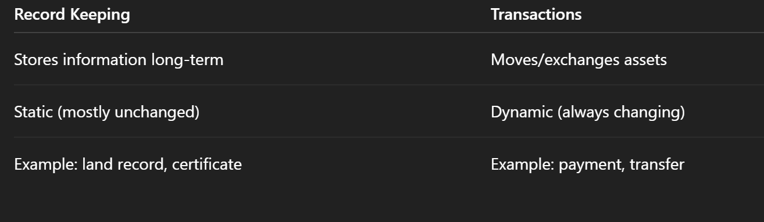
Comparison

Slide 8
How Record Keeping + Transactions work together in Blockchain
Blockchain is like a digital notebook that does two jobs at the same time:
Writes every transaction (movement)
Keeps the record forever (storage)
So → Transactions create data → Record keeping stores it permanently.

Slide 9
Blockchain in Advertising
Blockchain helps advertising become honest, transparent, and fraud-free. It makes sure:
Real people watched the ad 👀
Fake views / bots are removed ❌
Payment goes to the right person automatically 💰

Slide 10
Main idea
Buy-side transparency (for advertisers): → Blockchain keeps a clear record of where money was spent (auditing).
Sell-side transparency (for publishers): → Proof of View (PoV) confirms that a real person actually watched the ad.

Slide 11
What is Proof of View (PoV)?
PoV = Technology that checks real view vs fake view
It:
Records only logged-in users (real ID) ✔️
Rejects fake/multiple views from same user ❌
Randomly checks video frames to confirm real watching 🎥
Uses smart contracts to record views & send payment automatically 💸

Slide 12
Daily life example
Imagine a TV advertising company:
A company pays for 1,000 real viewers.
System checks:
Are viewers real people?
Did they actually watch the ad?
Fake views (bots, auto-play, cheating) are removed.
Payment is made only for real viewers.
This is similar to blockchain PoV — pay only for real watching.

Slide 13
Crypto / Blockchain example
On a blockchain-based ad platform:
Advertiser posts an ad and deposits money.
Users watch the ad.
PoV verifies:
Real user ID
Actually watching (not bot)
Blockchain records the view permanently.
Smart contract automatically:
Pays publisher (website/app owner)
Sometimes rewards viewer with tokens 🎁
Result: No fraud, full transparency, automatic payment.

Slide 14
Applications 1: Verifying the Authenticity of Returned Drugs
In the Pharma industry, drugs are frequently returned to the pharmaceutical manufacturers.
While the proportion of the returned drugs is small compared to the sales (about 2–3% of sales), the per year volume is in the range of $7–10 billion.
Currently, big pharma working with tech companies to develop Pharma Blockchain Proof of Concept (POC) app for this use case:

Slide 15
The system generates unique identifiers for a drug package.
When a manufacturer ships a package, they register the item on the Pharma POC Blockchain, with the four pieces of information generated by the ATTP; the item number (based on GS1 standard), a serial number, a batch number, and expiration date.
Using this PoC tracking will be easy, efficient and fast.

Slide 16
Applications 2: Transparency and traceability of consent in Clinical Trials
Informed patient consent involves making the patient aware of each step in the Clinical Trial process including any possible risks posed by the study. Clinical trial consent for protocols and their revisions need to be transparent for patients and traceable for stakeholders.
However, in practice, the informed consent process is difficult to handle in a rigorous and satisfactory way. The FDA reports that almost 10% of the trials they monitor feature some issues related to consent collection.

Slide 17
These include: failure to obtain written informed consent, unap proved forms, invalid consent document, failure to re-consent to a re vised protocol and missing Institutional Review Board approval to pro tocol changes, amongst others. Frequently also there are reported cases of document fraud such as issues of backdating consent documents.
Blockchain technology provides a mechanism for unfalsifiable time-stamping of consent forms, storing and tracking the consent in a secure and publicly verifiable way, and enabling the sharing of this information in real-time.
Additionally, smart contracts can be bound to protocol revisions, such that any change in the clinical trial protocol requires the patient consent needing renewal.

Slide 18
Applications 3: Insurance
Arguably, the greatest Blockchain application for insurance is through smart contracts. Such contracts powered by Blockchain could allow customers and insurers to manage claims in a truly transparent and secure manner, according to Deloitte.
All contracts and claims could be recorded on the Blockchain and validated by the network, which would eliminate invalid claims.
For example, the Blockchain would reject multiple claims on the same accident.

Slide 19
Blockchain can improve insurance by using smart contracts (automatic digital agreements). These smart contracts:
Automatically check if a claim is valid
Record all claims safely on blockchain
Stop fake or duplicate claims
Make the process transparent, fast, and secure
So, no cheating, no confusion, and less paperwork.

Slide 20
Daily Life Example 1
Imagine you buy car insurance.
You set a smart contract: If accident happens → pay repair money automatically.
Your car has sensors or police report confirms accident.
Blockchain checks data → accident is real ✔️
Payment is sent automatically to you.
Now suppose you try to claim twice for same accident ❌ Blockchain already recorded first claim → second claim rejected automatically. No fraud, no manual checking.

Slide 21
Daily Life Example 2
Vending Machine = Smart Contract
Insert money
Choose drink
Machine checks money
Condition true (enough money)
Drink comes automatically
No shopkeeper needed

Slide 22
Crypto / Blockchain Example
In blockchain insurance (like decentralized insurance):
A farmer buys weather insurance using smart contract.
Rule in contract: If rainfall < 20mm this month → automatic payout.
Weather data comes from trusted oracle.
If drought happens → smart contract sends crypto payment automatically.
If farmer tries to claim again for same drought ❌ Blockchain record shows claim already paid → duplicate claim rejected.

Slide 23
Smart Contract — Easy 5 Steps
Step 1 — Create Rules 📝 Two people make an agreement in code. Example rule: If condition happens → payment sent automatically.
Step 2 — Put on Blockchain 🔗 The contract is uploaded to blockchain, so no one can change or cheat it.
Step 3 — Wait for Condition ⏳ The smart contract keeps watching for the condition to happen.
Step 4 — Condition Met ✔️ When the condition becomes true, the contract checks it automatically.
Step 5 — Auto Action ⚡ Contract executes itself → sends money / records data / completes task. No middleman, no delay, no cheating.

Slide 24
Application 4: Real Estate
The average homeowner sells his or her home every 5 to 7 years, and the average person will move nearly 12 times during his or her lifetime. With such movement, Blockchain could certainly be of use in the real estate market.
It would expedite home sales by quickly verifying finances, would reduce fraud thanks to its encryption, and would offer transparency throughout the entire selling and purchasing process.

Slide 25
EXPLAINATION
In real estate (buying/selling houses), blockchain can make the process:
Faster ⚡ (quick verification of money and documents)
Safer 🔒 (hard to cheat because records cannot be changed)
Transparent 👀 (everyone can see correct history)
This helps reduce fraud and speeds up buying and selling property.

Slide 26
Daily Life Example
Normal house buying:
You want to buy a house
Bank checks your money (takes many days)
Papers checked manually
Risk of fake documents or hidden issues
With blockchain:
Property records stored on blockchain
Buyer money verified quickly
Smart contract transfers ownership automatically after payment
All history visible → no fake ownership, no cheating
So, faster + safer + clear deal.

Slide 27
Crypto / Blockchain Example
Tokenized Real Estate
A house is converted into digital tokens on blockchain
Each token = small ownership share of property
Buyer sends crypto → smart contract transfers property tokens automatically
Ownership recorded permanently on blockchain
No middleman, less paperwork, fast transfer.
Blockchain in real estate = faster property transfer + fraud protection + transparent ownership history.

Slide 28
TOkenization??
Tokenization = converting a real thing into digital tokens on blockchain.
Each token = small digital share of something (house, gold, art, money, etc.).
So instead of buying the whole thing, you can buy small parts easily.

Slide 29
Daily Life Example
Imagine a pizza 🍕
Whole pizza = real asset (like house)
Pizza cut into 8 slices = tokens
Each slice = small ownership
You don’t need to buy full pizza → you can buy 1 slice only.
Same idea in tokenization.

Slide 30
Crypto / Blockchain Example
Tokenized House
Real house value = $100,000
Converted into 10,000 tokens on blockchain
1 token = $10 share of house
If you buy 100 tokens → you own small part of that house.
You can:
Sell tokens anytime
Buy more tokens
Earn rent share (if property gives income)
All ownership recorded safely on blockchain.

Slide 31
Why Tokenization is Useful
Buy small share (no need big money) 💰
Easy to buy/sell ⚡
Transparent ownership 👀
Safe record on blockchain
Tokenization = turning real assets into small digital shares (tokens) on blockchain.

Slide 32
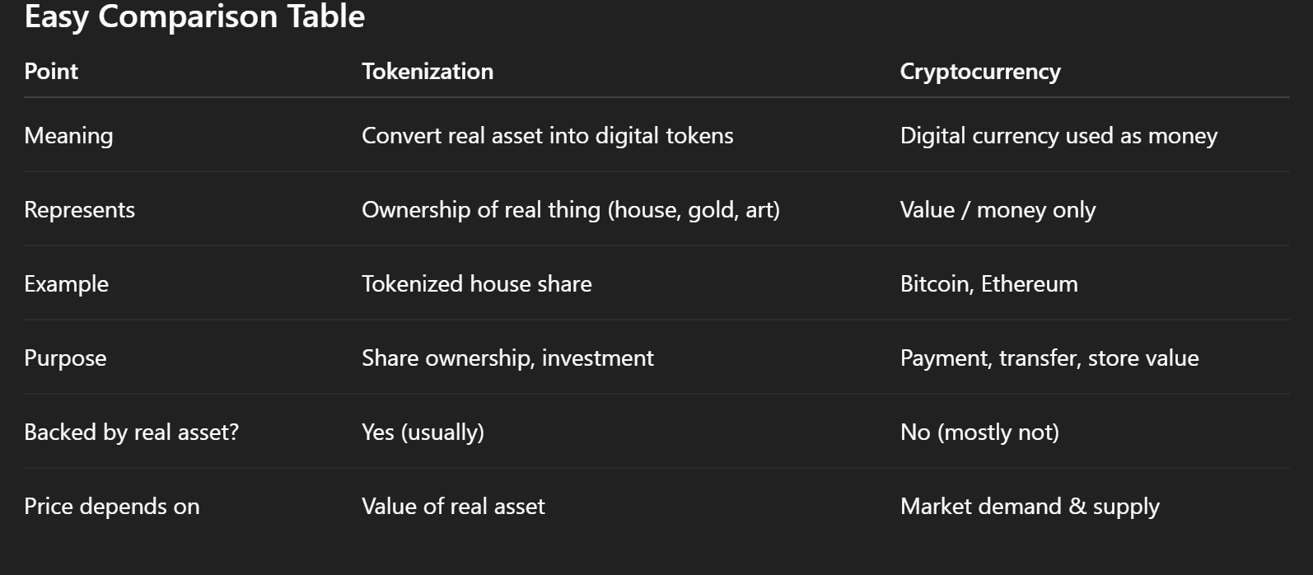
Simple Idea
Tokenization = digital share of a real asset
Cryptocurrency = digital money

Slide 33
Daily Life Example
Tokenization: A building is divided into 1,000 digital shares → you buy 10 shares → you own small part of building.
Cryptocurrency: You send digital money to your friend like online cash.

Slide 34
Application 5: Energy
Blockchain technology could be used to execute energy supply trans actions, but it could further provide the basis for metering, billing, and clearing processes, according to PWC.
Other potential applications include documenting ownership, asset management, origin guarantees, emission allowances, and renewable energy certificates.

Slide 35
Daily Life Example
Imagine your home has solar panels:
Your panels produce extra electricity
Smart meter records how much energy you generate
Blockchain records this data safely
Extra electricity automatically sold to neighbor
Payment sent to you automatically
No manual billing, no cheating, correct record ✔️

Slide 36
Crypto / Blockchain Example
Peer-to-Peer Energy Trading
Houses with solar panels produce electricity
Energy units converted into digital tokens on blockchain
You sell extra energy tokens to another user
Smart contract automatically transfers:
Energy → to buyer ⚡
Crypto payment → to you 💰
Blockchain also records:
Renewable energy proof
Carbon credits
Energy ownership
Blockchain in energy = automatic billing + secure energy records + easy renewable energy trading.

Slide 37
Application 6: Record Management
National, state, and local governments are responsible for maintaining individuals’ records such as birth and death dates, marital status, or property transfers.
Yet managing this data can be difficult, and to this day some of these records only exist in paper form and sometimes, citizens have to physically go to their local government offices to make changes, which are time-consuming, unnecessary, and frustrating. Blockchain technol ogy can simplify this record-keeping.

Slide 38
Daily Life Example
Birth Certificate on Blockchain
When a baby is born → hospital uploads record to blockchain
Record becomes permanent and secure
Parents don’t need to visit offices again and again
School, passport office, government can verify instantly
No risk of losing paper or fake certificate
Everything is safe + fast + always available.
Blockchain record management = permanent, secure, and fraud-proof digital record keeping.

Slide 39
Crowdfunding
Blockchain technology, among all its benefits, can be best put to use by providing provable milestones as contingencies for giving, with smart contracts releasing funds only once milestones establish that the money is being used the way that it is said to be.
By providing greater oversight into individual campaigns and reducing the amount of trust required to donate in good conscience, crowdfunding can become an even more legitimate means of funding a vast spectrum of projects and causes, Figure 3.1 shows How Blockchain Is Revolutionizing Crowd funding.

Slide 40
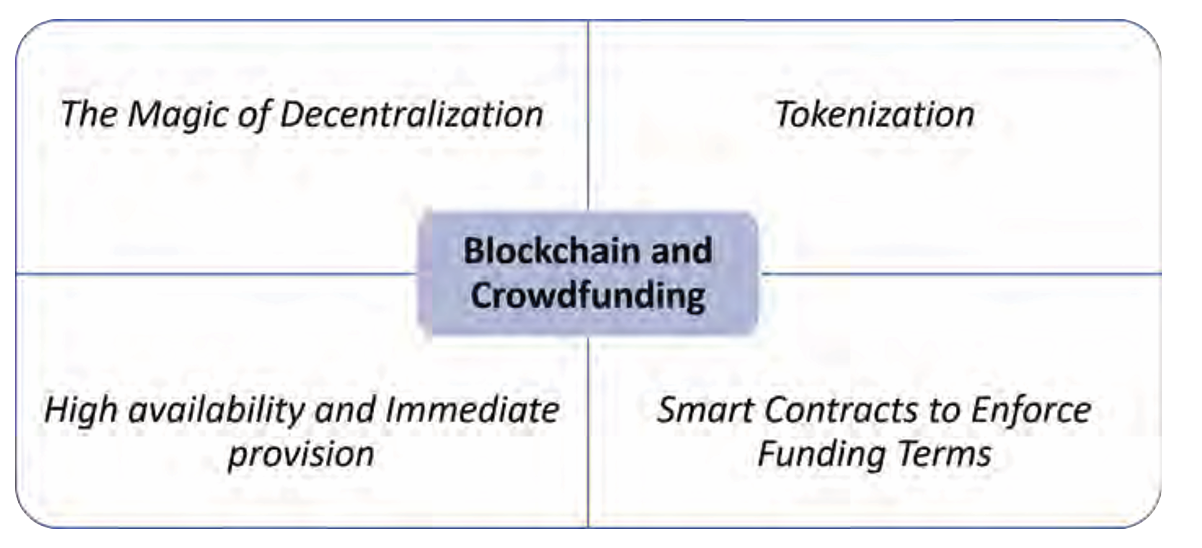
Blockchain and Crowdfunding

Slide 41
Decentralization → No central authority controlling funds
Tokenization → Investors may receive project tokens/shares
High availability → Funding open to anyone, anytime
Smart contracts → Automatically enforce funding rules

Slide 42
Explanation
Crowdfunding = collecting small money from many people for a project.
Blockchain improves crowdfunding by:
Releasing money step-by-step (milestones) 💡
Using smart contracts to control funds automatically 🤖
Showing where money is used (transparent) 👀
Reducing fraud and misuse ❌
So donors trust more because money is only released when work is done.

Slide 43
Daily Life Example
Imagine people collect money to build a school:
Goal: $10,000
Smart contract rules:
After land bought → release $3,000
After building foundation → release $4,000
After school completed → release remaining $3,000
If builder does not complete step ❌ → money not released.
So funds are safe + controlled + transparent.

Slide 44
Crypto / Blockchain Example
Blockchain Crowdfunding (like ICO / DAO funding)
A startup wants funding → creates smart contract
Investors send crypto to contract
Funds locked safely on blockchain
Money released only when milestones completed:
Product prototype ready ✔️ → release funds
App launched ✔️ → release next funds
If project fails ❌ → remaining funds can return to investors (depending on contract).
No middleman, no cheating, full transparency.

Slide 45
Blockchain Technology and Supply Chain Management
Managing today’s supply chains is extremely complex. For many products, the supply chain can span over hundreds of stages, multiple geographical (international) locations, a multitude of invoices and payments, have several individuals and entities involved, and extend over months of time. Due to the complexity and lack of transparency of the current supply chains, there is high interest in how Blockchains might transform the supply chain and logistics industry.
This interest rose from the long list of issues with current Supply Chain Management (SCM) including:
Difficulty of Tracking
• Lack of Trust
• High Costs: procurement costs, transportation costs, inventory costs and quality costs
• Globalization Barriers

Slide 46
Blockchain and SCM (continue)
Blockchain technology and supply chain management systems were built for each other in many ways. In fact, several of the flaws of the current supply chains can be easily relieved by using Blockchain technology. Supply Chain Management (SCM) is one of the fore most industries that Blockchain can disrupts and changes for the better.

Slide 47
With Blockchain technology properties of decentralization, trans parency, and immutability, it is the perfect tool to save the supply chain management industry. Subsequently, Blockchain can increases the ef f iciency and transparency of supply chains and positively impact ev erything from warehousing to delivery to payment. Most importantly, Blockchain provides consensus—there is no dispute in the chain re garding transactions because all entities on the chain have the same version of the ledger

Slide 48
Traceability, and Transparency
Blockchain can have a big impact on SCM in two dimensions Traceability, and Transparency.
Traceability Blockchain improves operational efficiency by mapping and visualizing enterprise supply chains. A growing number of con sumers demand sourcing information about the products they buy. Blockchain helps organizations understand their supply chain and en gage consumers with real, verifiable, and immutable data.

Slide 49
Transparency Blockchain builds trust by capturing key data points, such as certifications and claims, and then provides open access to this data publicly. Once registered on the Blockchain, its authenticity can be verified by a third-party. The information can be updated and vali dated in real-time. Plus, the strong security from its innate cryptogra phy will eliminate unnecessary audits, saving copious amounts of time and money

Slide 50
Applying Blockchain technology to SCM can results in tremendous benefits, including
Less Time Delays
Less Human Error
Less Costs

